Slide 1

How to Create Popular Music on Spotify?
Shiyu Pan
Chuyang Yu

Slide 2

Contents
Introduction to Music Properties
Popularity Time Trend
Affects of Properties on Popularity
Correlations between Different Properties
Preference Map

Slide 3

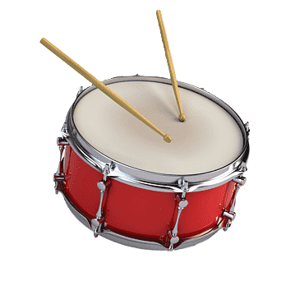


Music Properties
Tempo
0 – 250 BPM
The speed of a track, influencing its energy and rhythmic feel
Loudness
-60 – 0 dB
The overall perceived volume of a track, influencing its intensity and presence
Energy
0 – 1 Index
A track’s perceived intensity, combining factors like dynamic range, timbre, and rhythmic stability

Slide 4

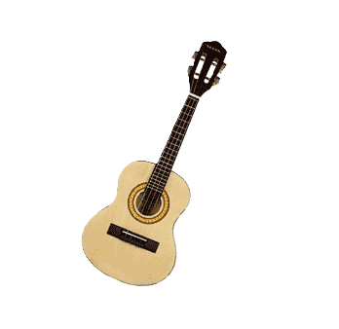


Music Properties
Danceability
0 – 1 Index
How well a track’s tempo, rhythm stability, beat strength, and overall structure support dancing
Acousticness
0 – 1 Index
The degree to which a track is composed of acoustic sounds rather than electronic elements
Valence
0 – 1 Index
The positivity conveyed by a track, with higher values indicating happier and more cheerful tones
Mode
Major – Bright, uplifting, and cheerful
Minor – Darker, moody, and dramatic feel

Slide 5
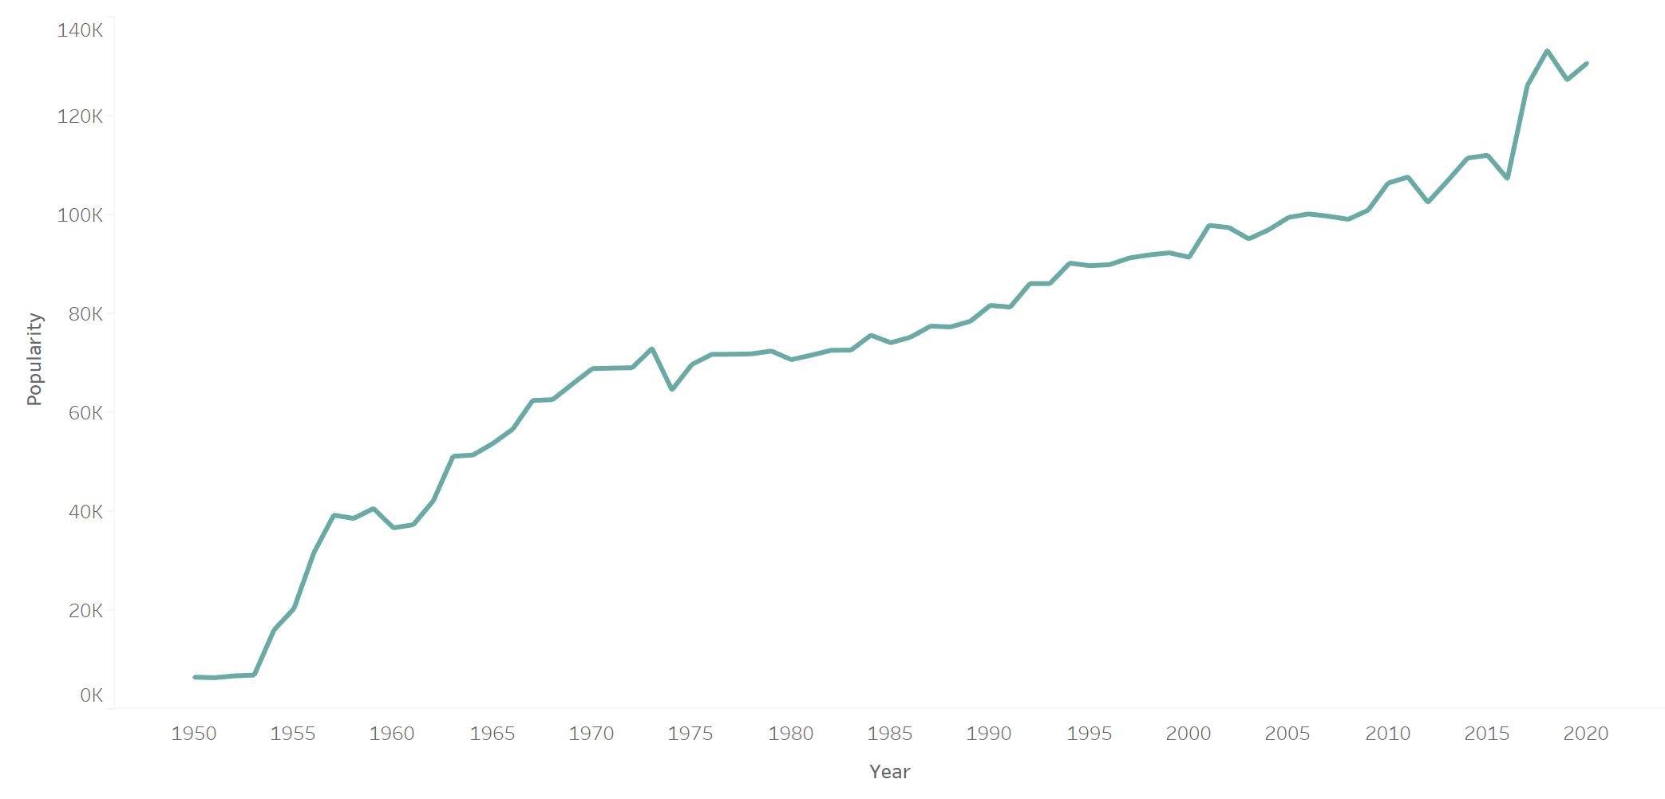

Popularity Time Trend
Up and Steady Vibes
From 1950 – 2025, the growth slowed but never stopped!
Launched in 2008
Have a boost in the 2010s

Slide 6
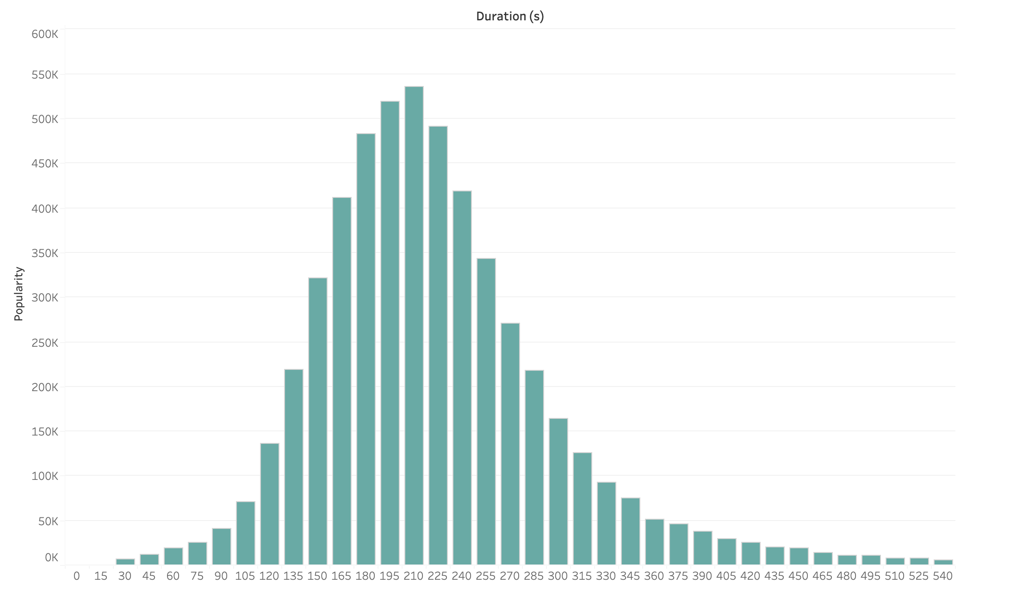
Affects of Properties on Popularity
How does Duration change music popularity ?
210 s
Too short (< 2 min)
Not enough buildup & emotional impact!
Too long (> 5 min)
Skip this track…

Slide 7
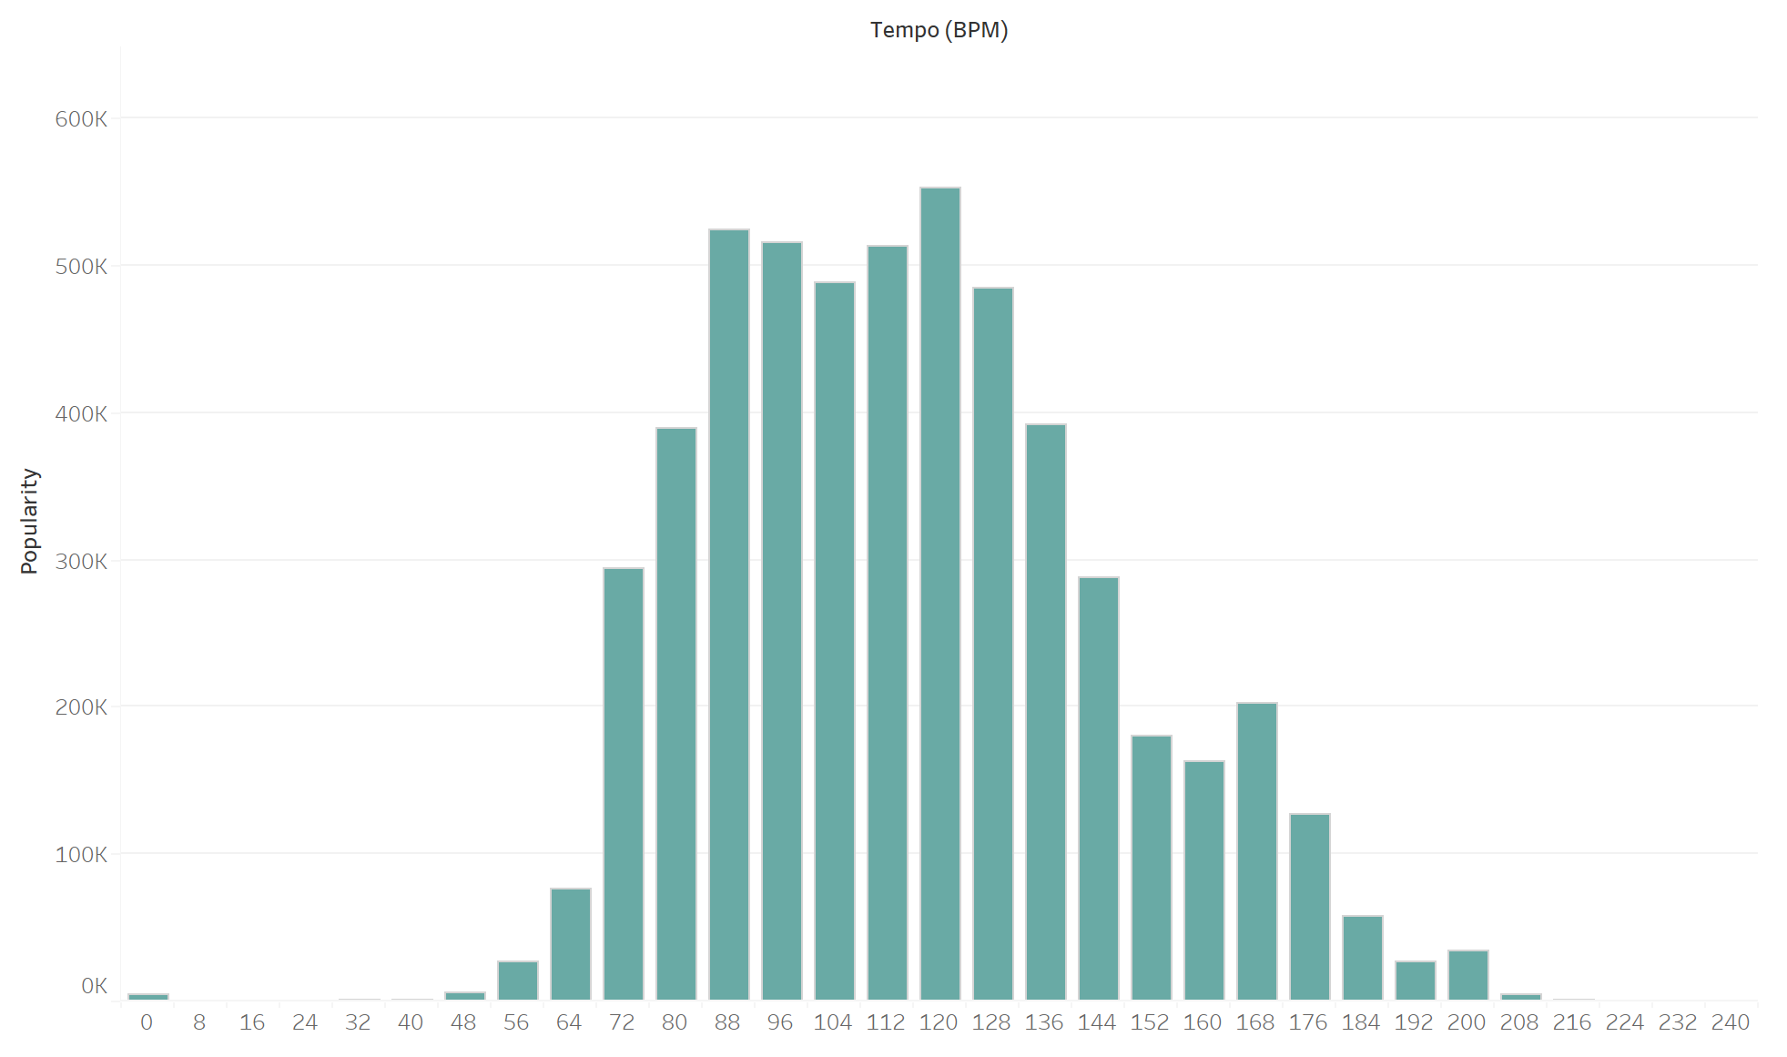
Affects of Properties on Popularity
How does Tempo change music popularity ?
120 BPM
Too slow (< 72BPM)
Maybe too chill to keep listeners engaged
Too fast (> 140 BPM)
Maybe too intense for casual listening

Slide 8
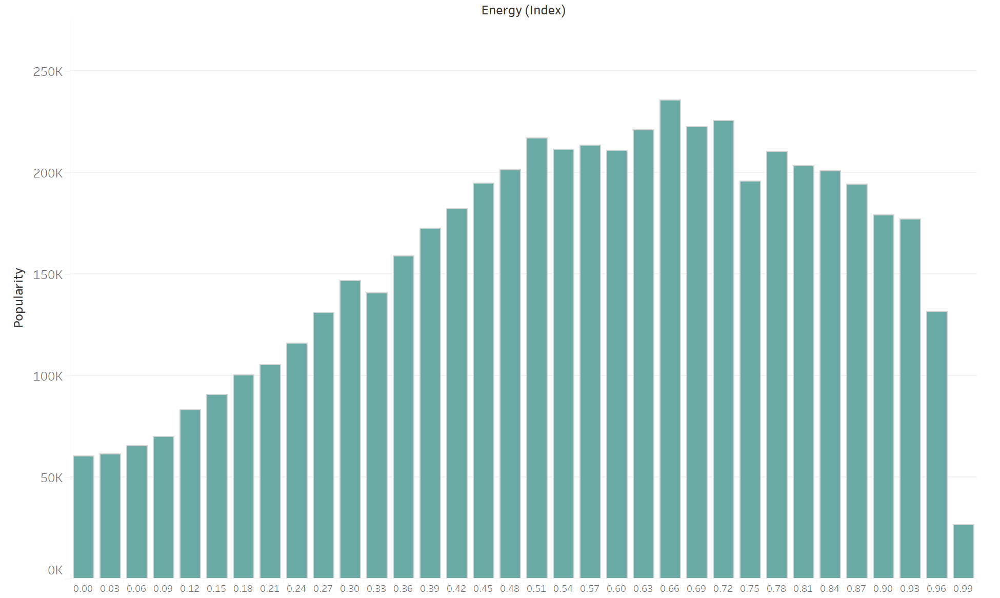
Affects of Properties on Popularity
How does Energy change music popularity ?
0.66
Too weak (< 0.3)
Make people feel sleepy – don’t get that much love…
Too strong (> 0.9)
People don’t want to be in full turbo mode all the time

Slide 9
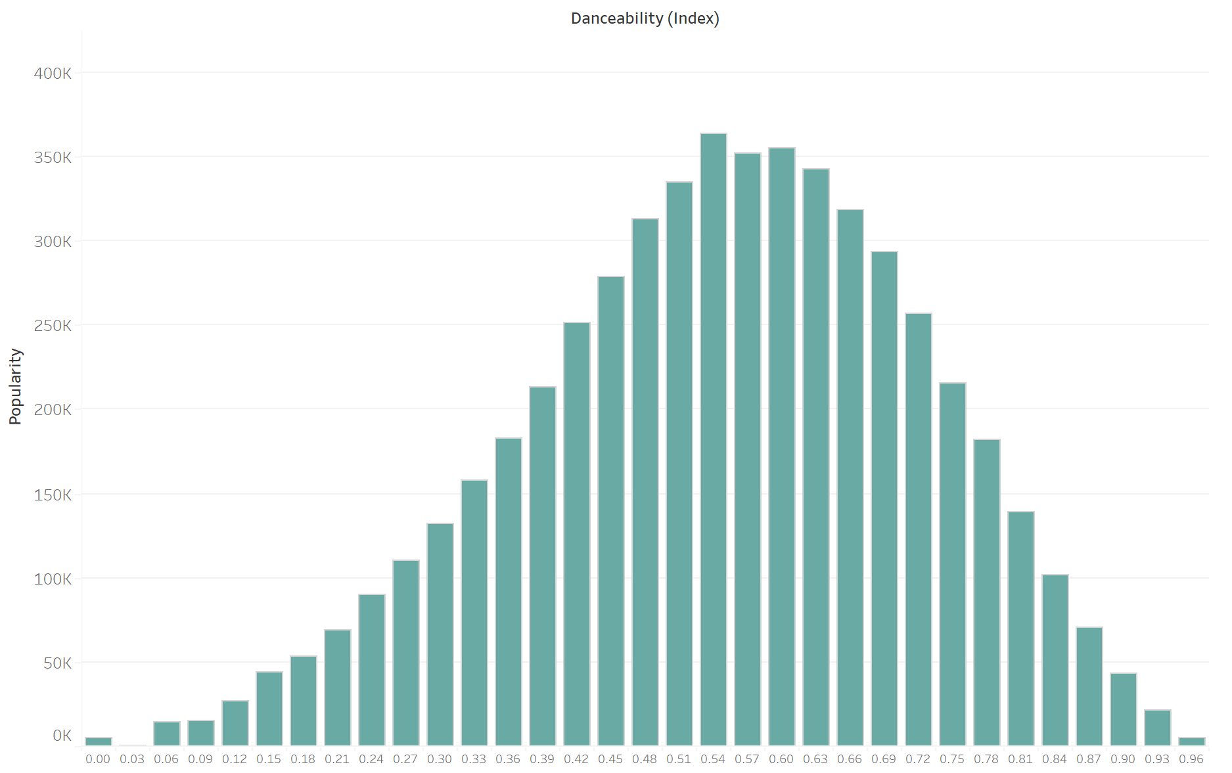
Affects of Properties on Popularity
How does Danceability change music popularity ?
0.54
Too stiff (< 0.39)
Maybe they’re better for deep thoughts than dance…
Too bouncy (> 0.75)
The full-on dance tracks are too niche and intensive!

Slide 10
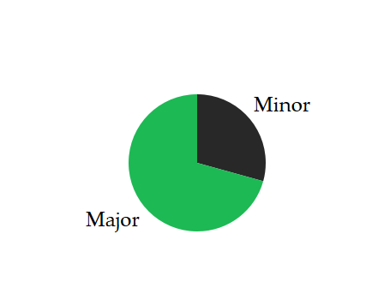
Mode Preference
How does Music Mode change music popularity ?
70.69%
Major-key
Balanced tempo, energy, and danceability make a track catchy and joyful ☺
Minor-key
Less popular but still have a place – resonate with a certain mood ˘◡˘

Slide 11
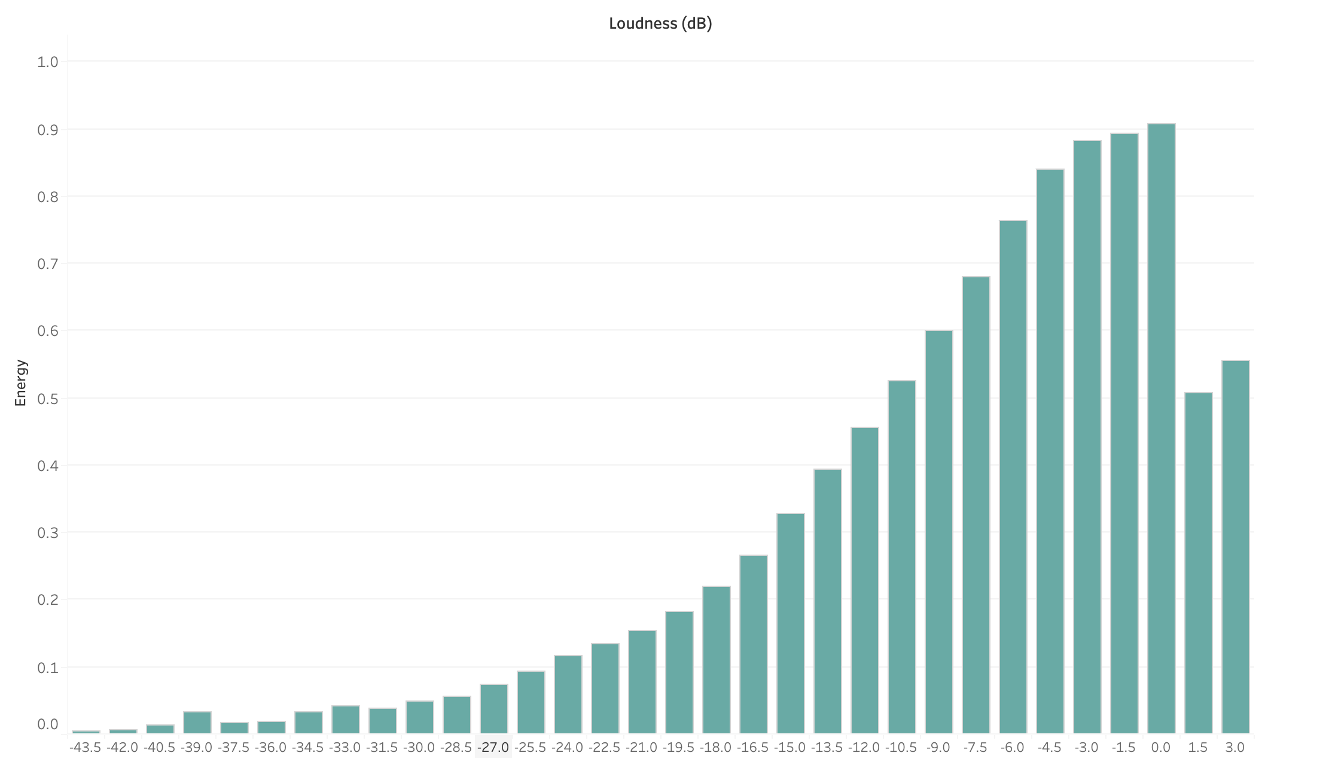
Correlations between Different Properties
How does Loudness change music Energy?
Strong Positive Correlation
As Loudness (dB) increases, Energy (Index) tends to increase as well.
Energy peaks around Loudness -1.5~0.0 dB.

Slide 12
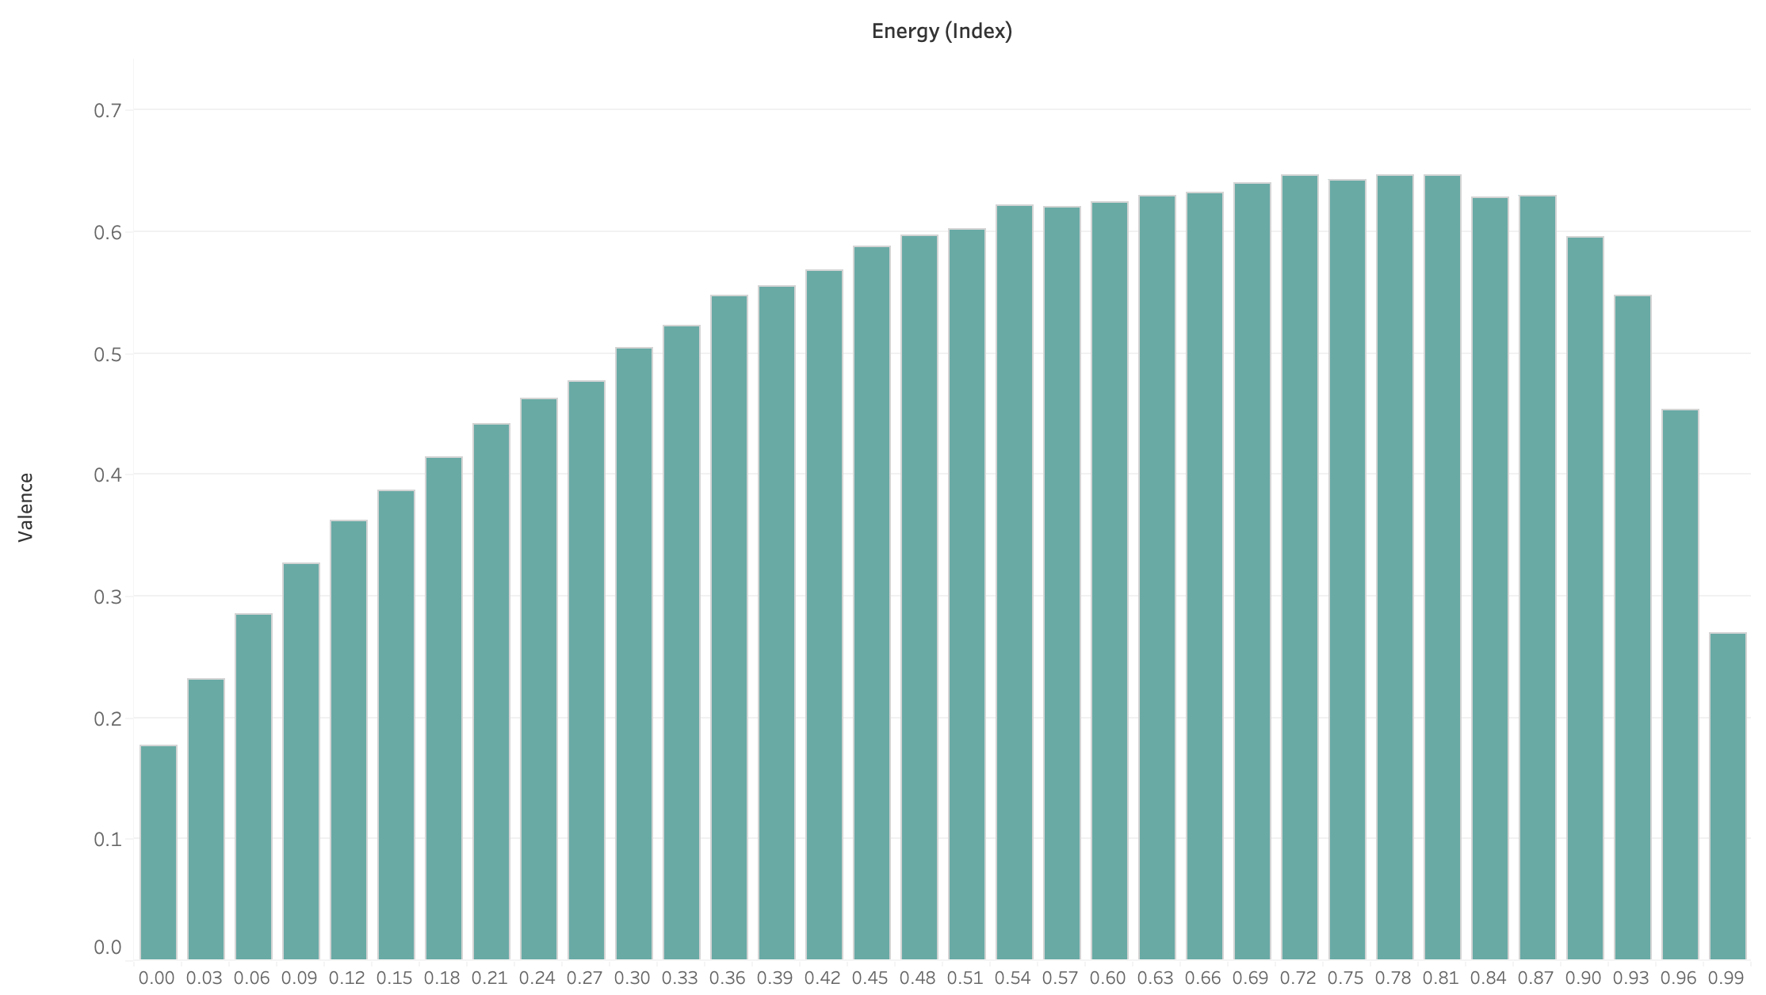
Correlations between Different Properties
How does Energy change audience Valence?
Inverted U-Shape Correlation
Low Energy:
Sad & Calm – Low Valence
Moderate Energy:
Lively & Engaging – Valence Peaks
High Energy:
Tense & Aggressive – Valence Declines
Valence peaks around Energy 0.72~0.81

Slide 13
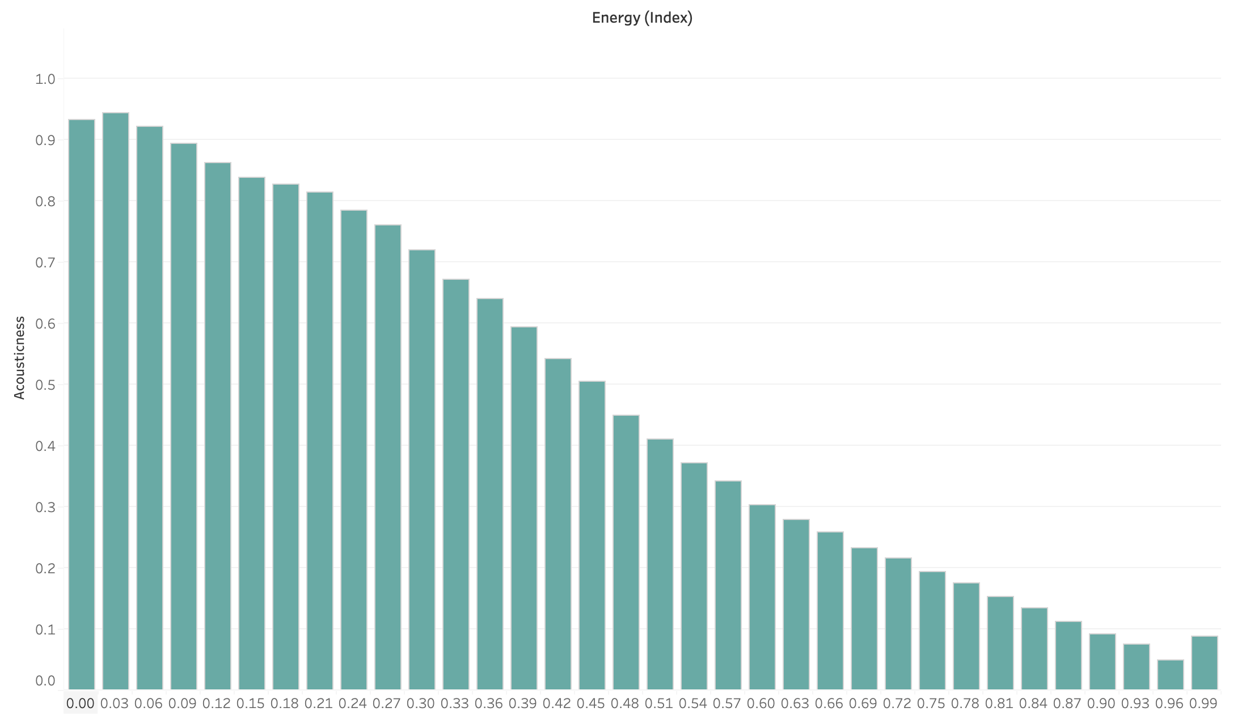
Correlations between Different Properties
How does Energy change music Acousticness?
Strong Negative Correlation
Higher-Energy music often involves electronic production, strong beats, and amplified sound, which reduces its Acousticness (Softness & Tenderness).
Acousticness peaks around Energy 0.00~0.03

Slide 14
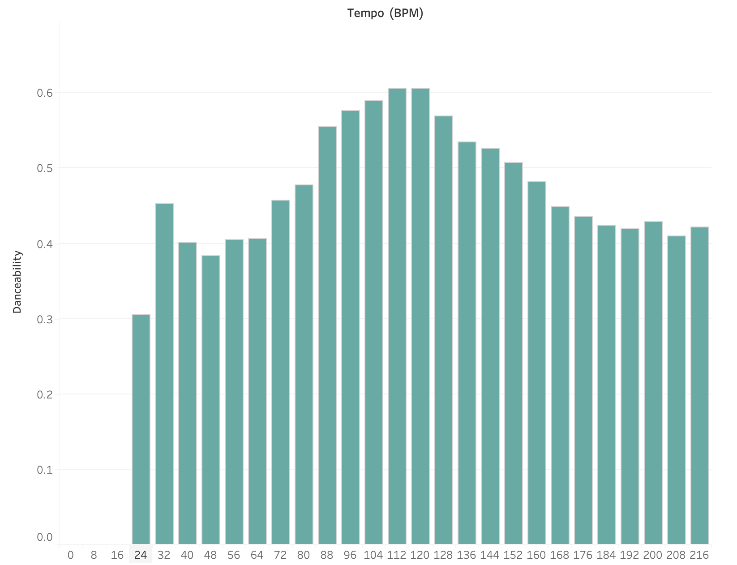
Correlations between Different Properties
How does Tempo change music Danceability?
Inverted U-Shape Correlation
Slow Tempos (Below 60 BPM):
Too Sluggish for Dancing– Lower Danceability
Moderate Tempos (90–130 BPM):
Optimal Tempo for Dancing – Highest Danceability Range
Fast Tempos (Above 150 BPM):
Too Chaotic for Dancing – Danceability Declines
Danceability peaks around Tempo 120 BPM.

Slide 15
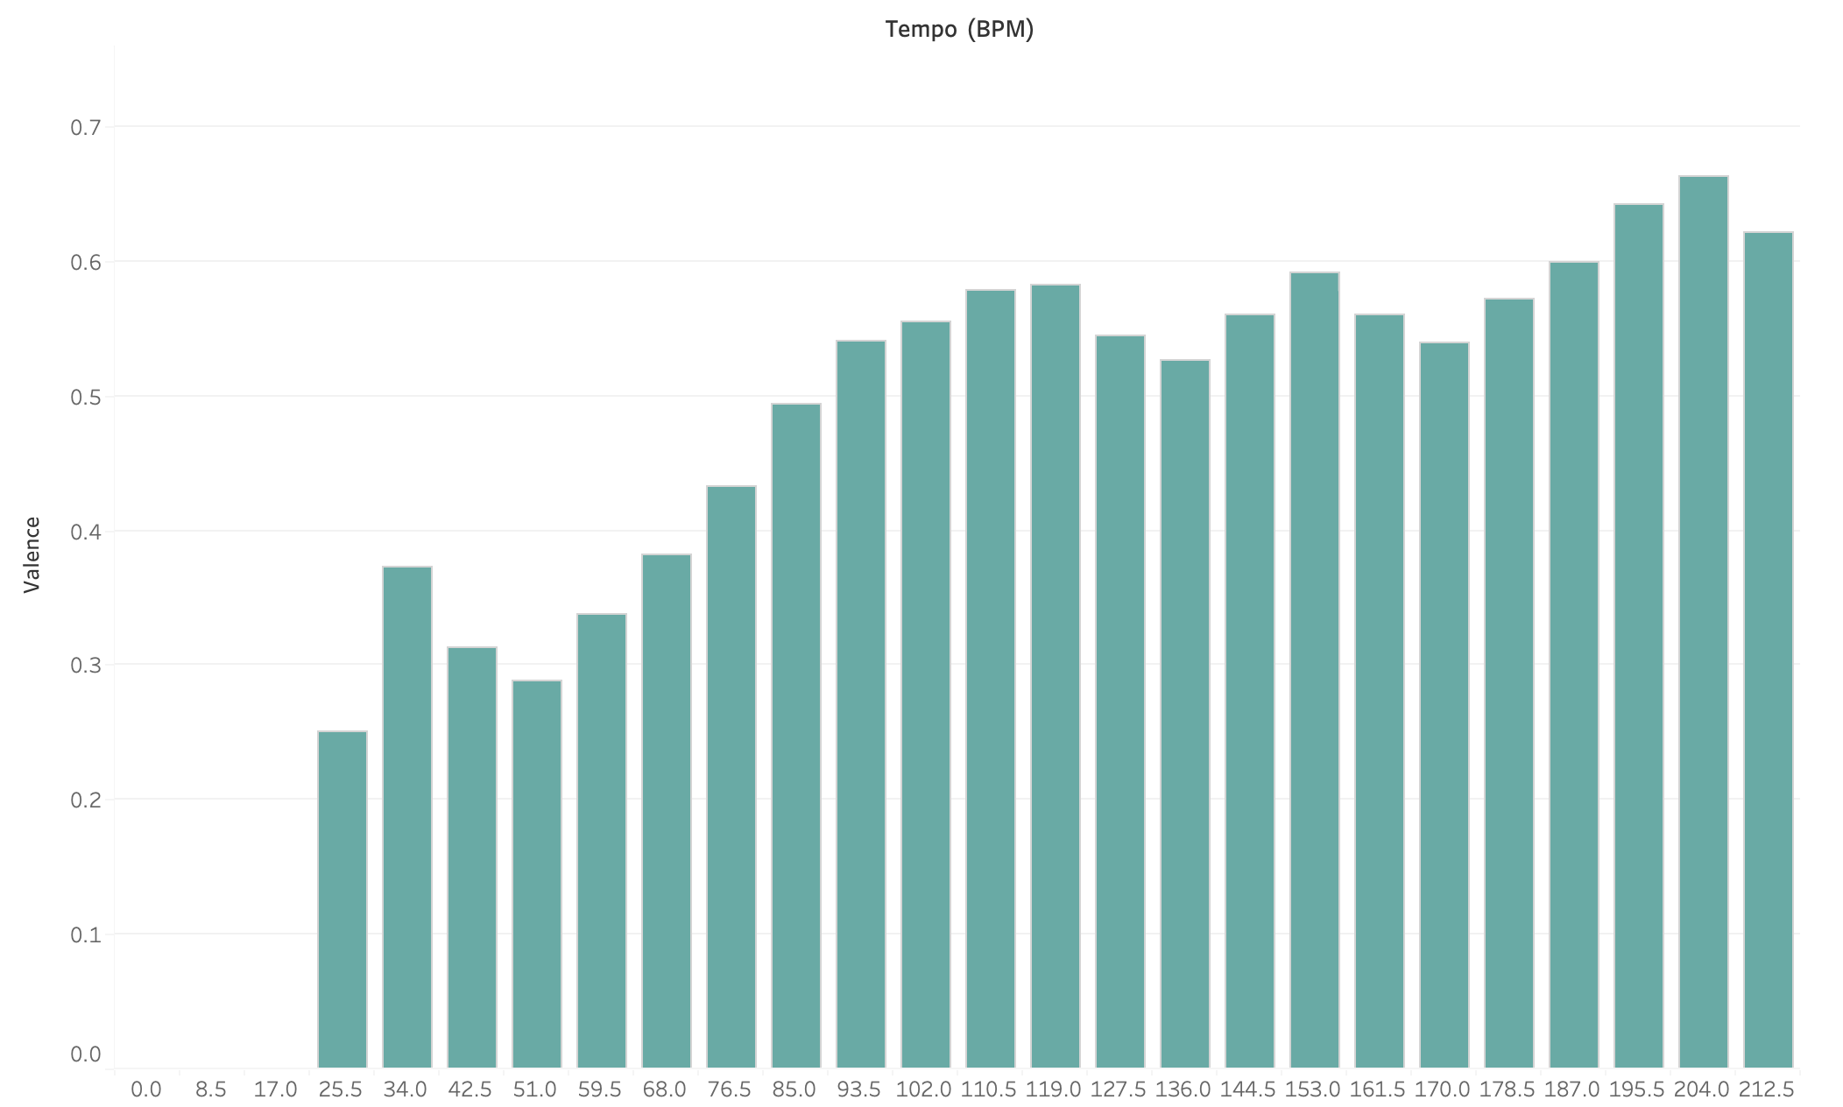
Correlations between Different Properties
How does Tempo change audience Valence?
Positive Correlation
As Tempo increases, the Valence generally increases.
Low Tempo:
Slower & Sadder – Lower Valence
As Tempo Increasing:
Upbeat & Happier – Valence Increases
Extremely High Tempo:
Anxiety & Tension – Valence Declines
Valence peaks around Tempo 204 BPM.

Slide 16
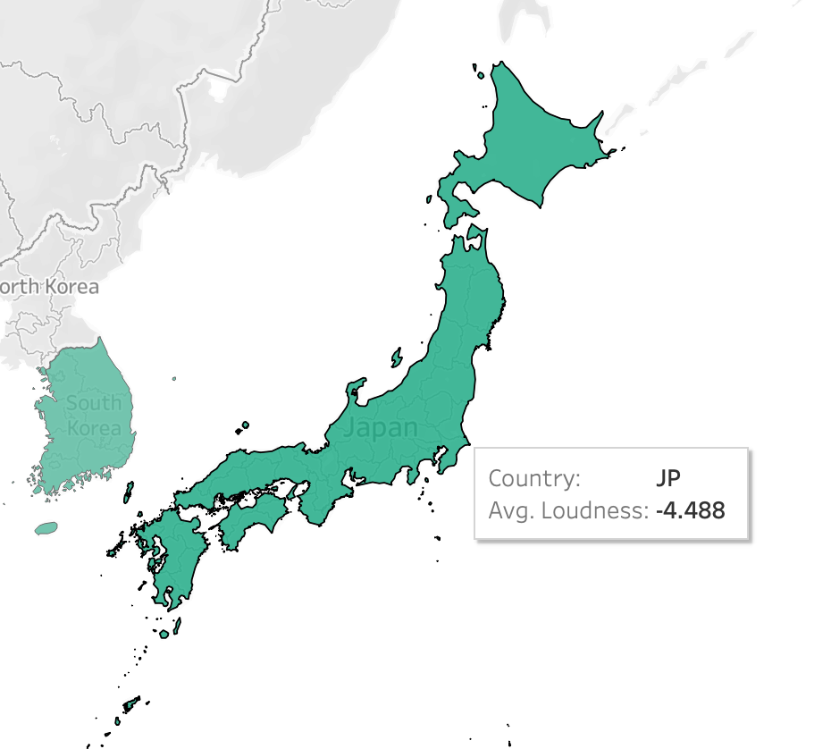
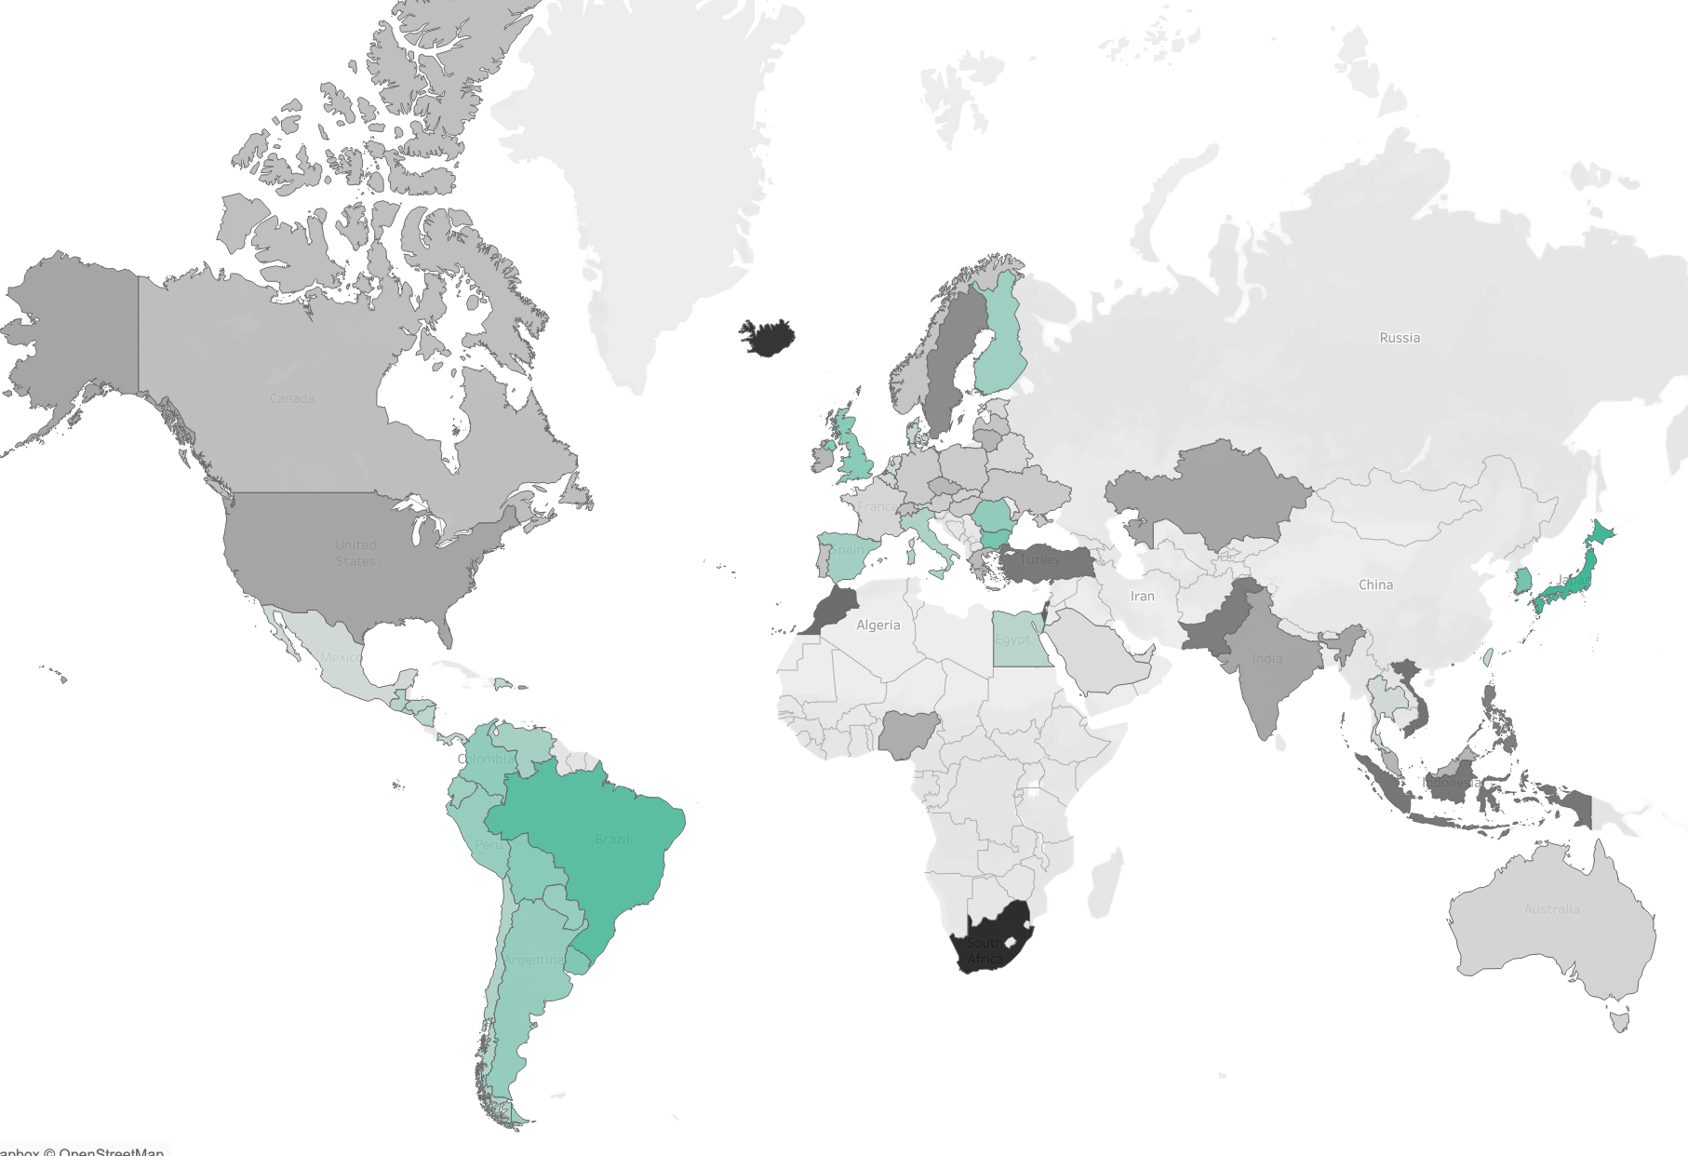
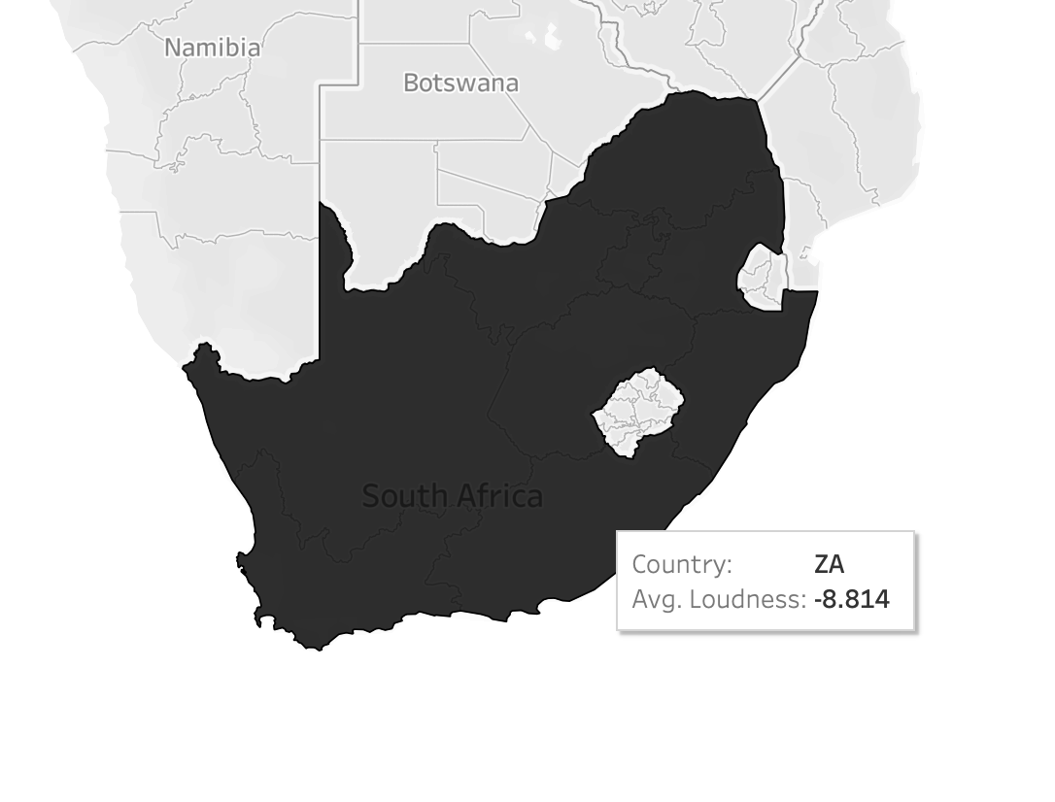
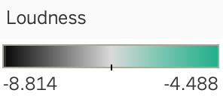
Preference Maps
Loudness Preference Map
MAX
Japan
MIN
South Africa

Slide 17
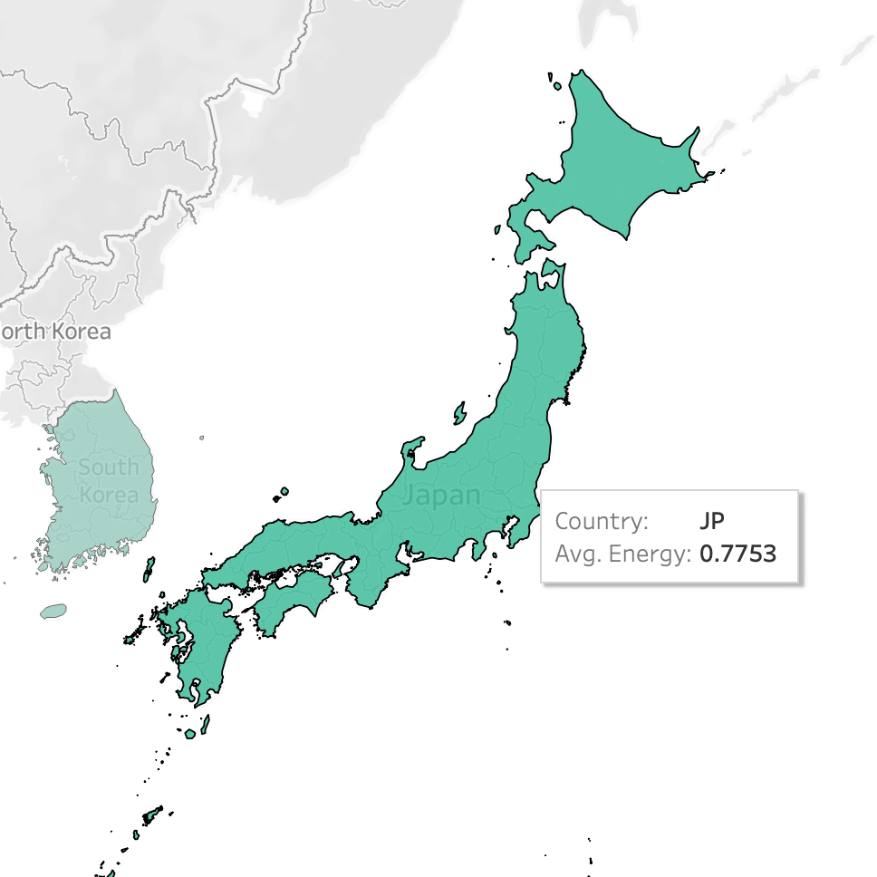
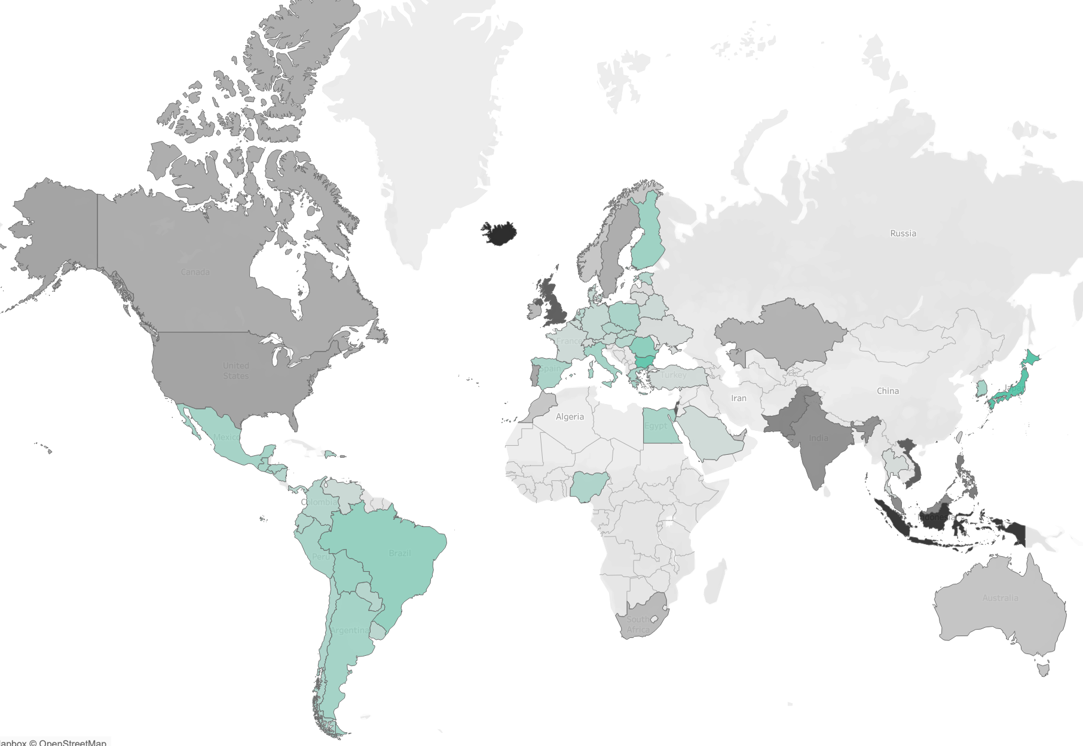
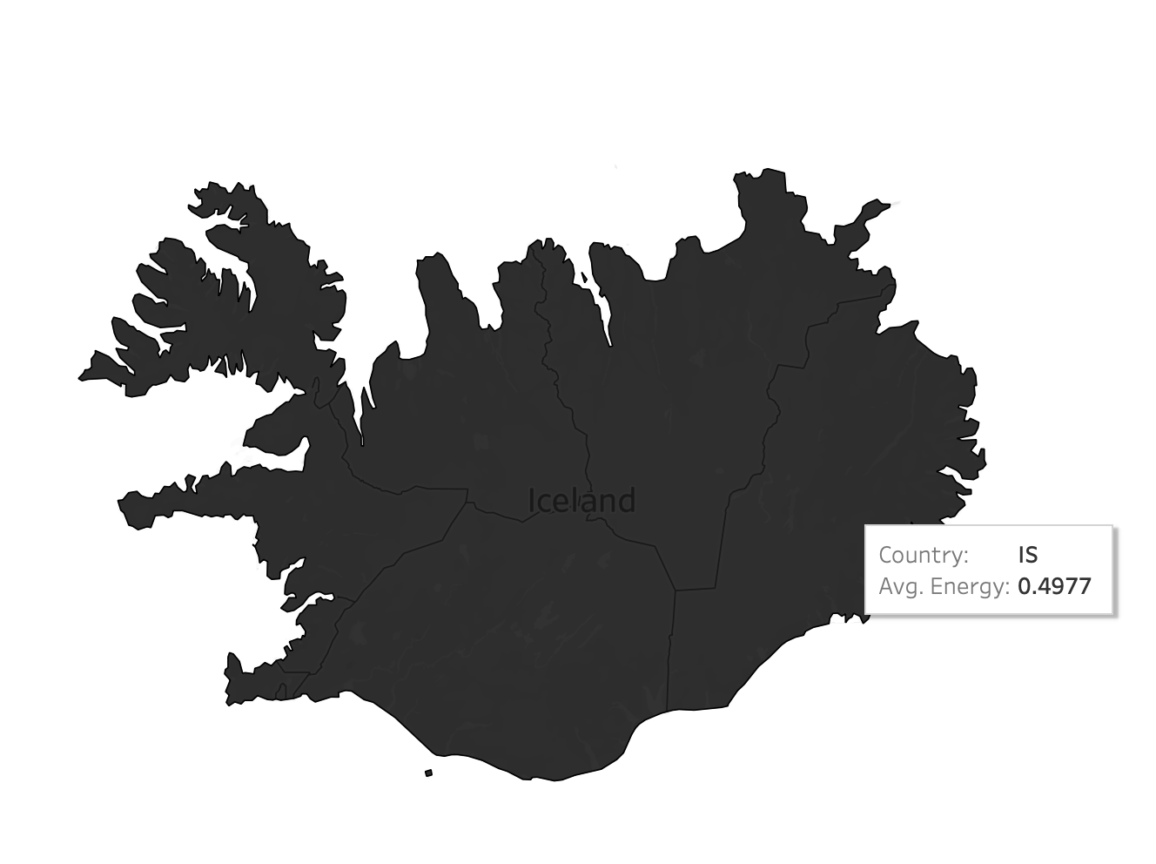
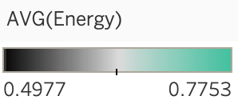
Preference Maps
Energy Preference Map
MAX
Japan
MIN
Iceland

Slide 18
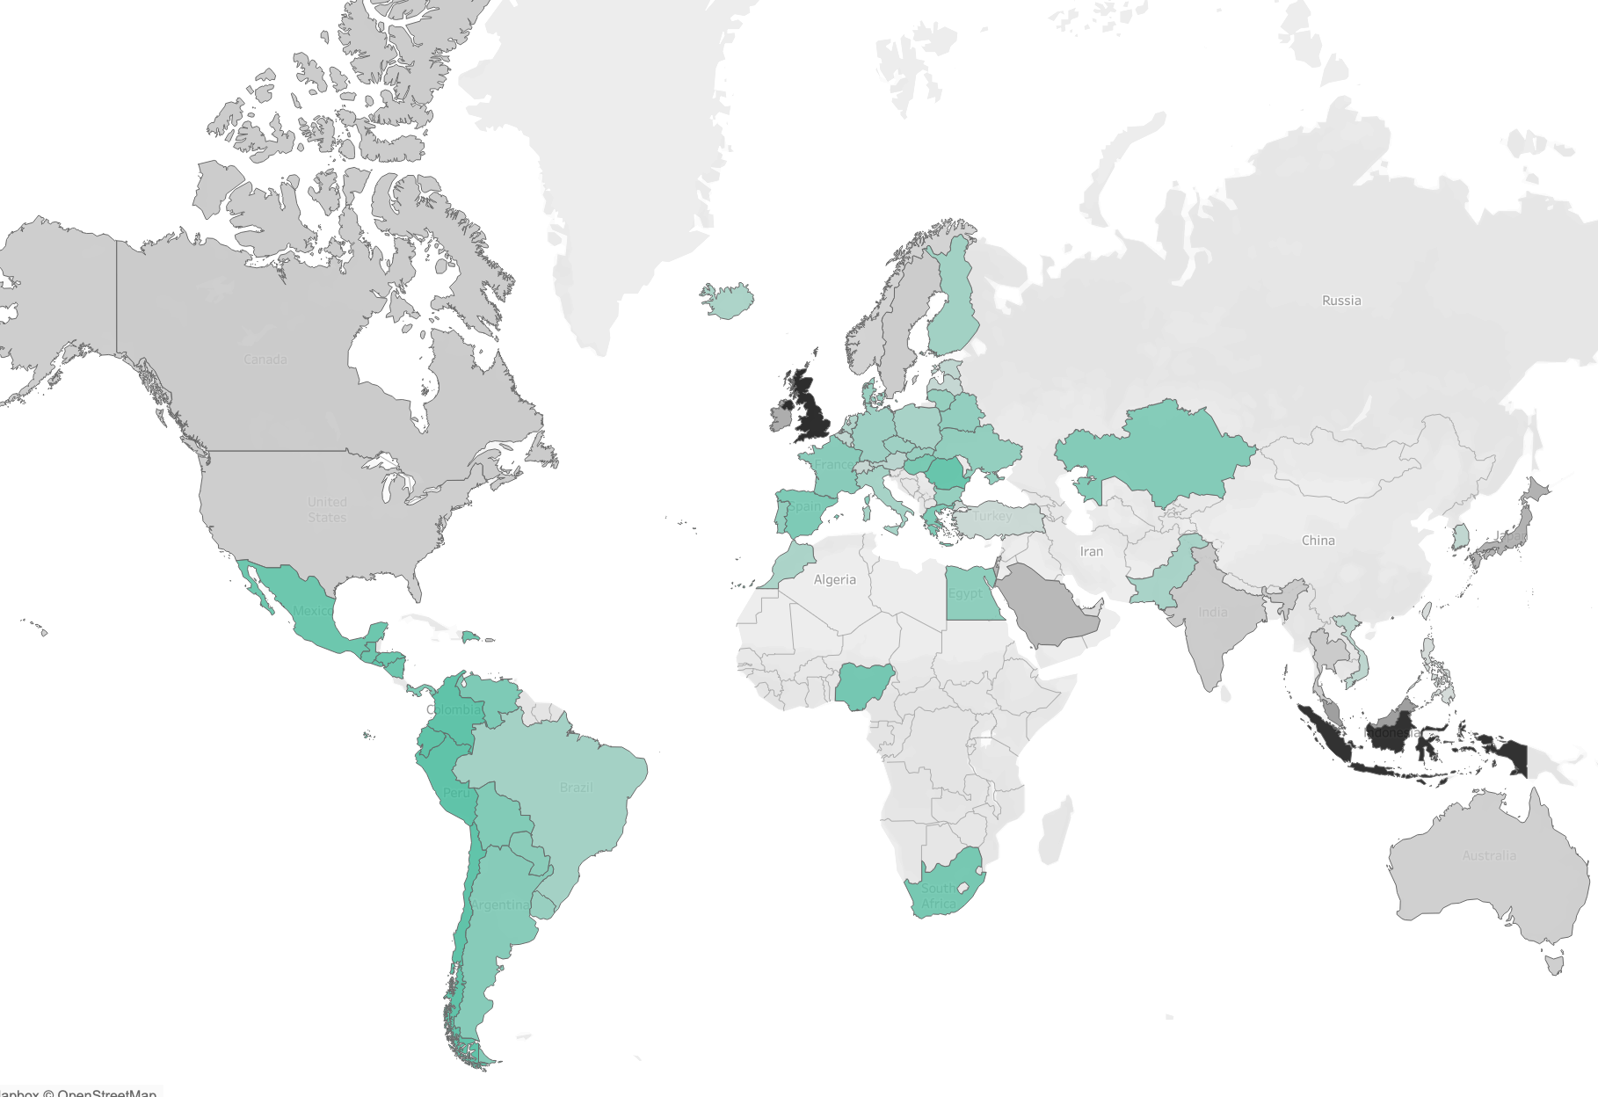
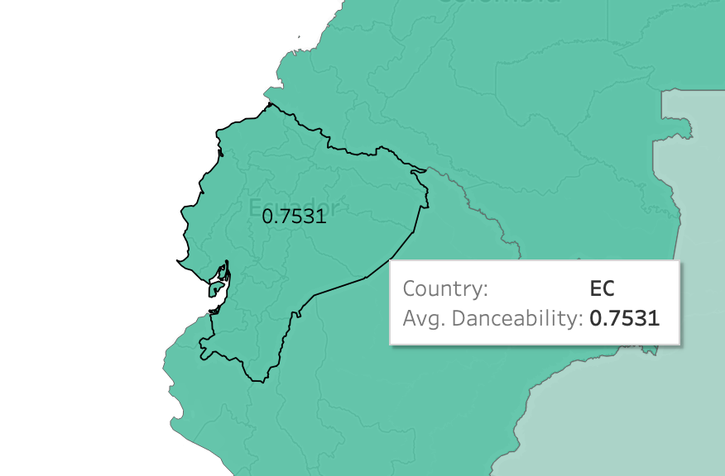
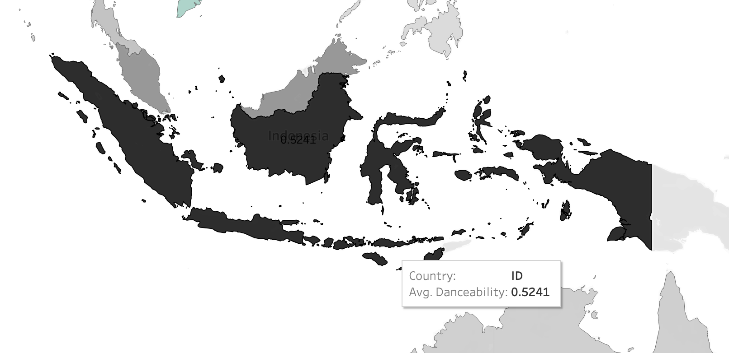
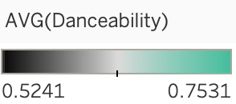
Preference Maps
Danceability Preference Map
MAX
Ecuador
MIN
Indonesia

Slide 19
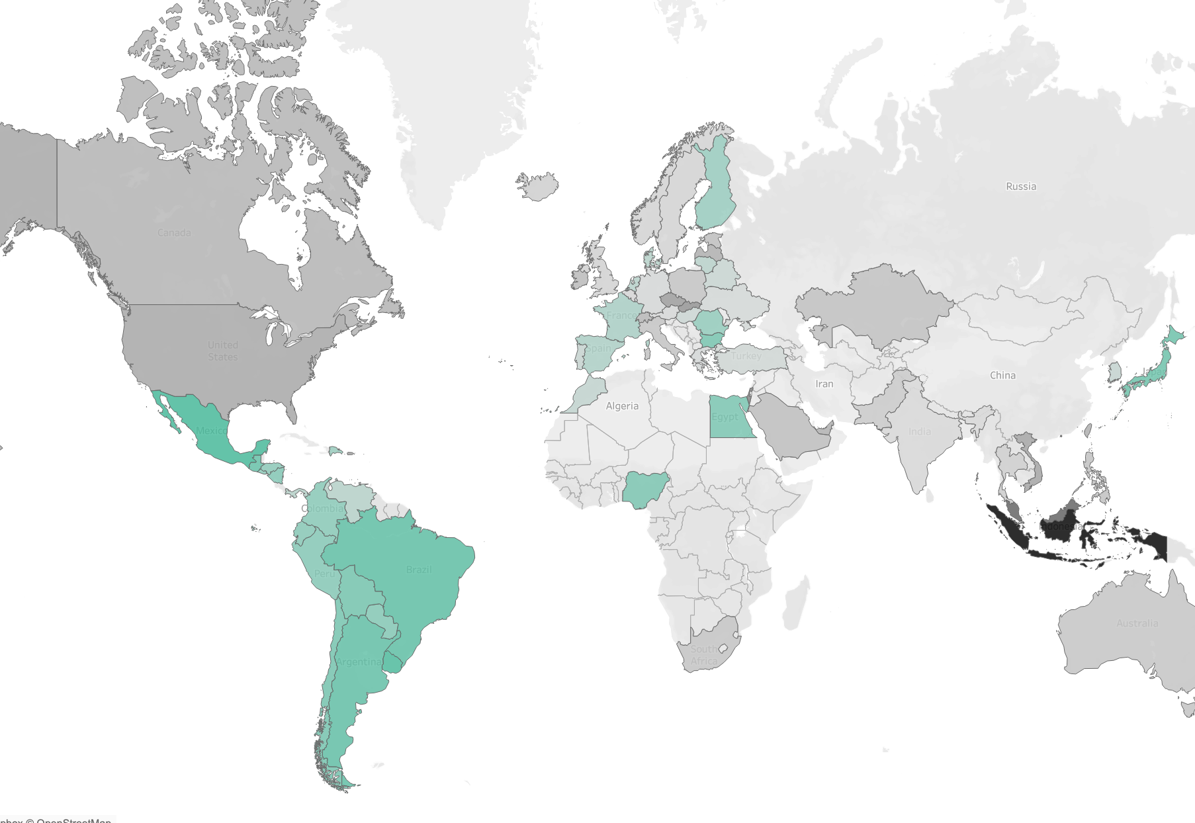
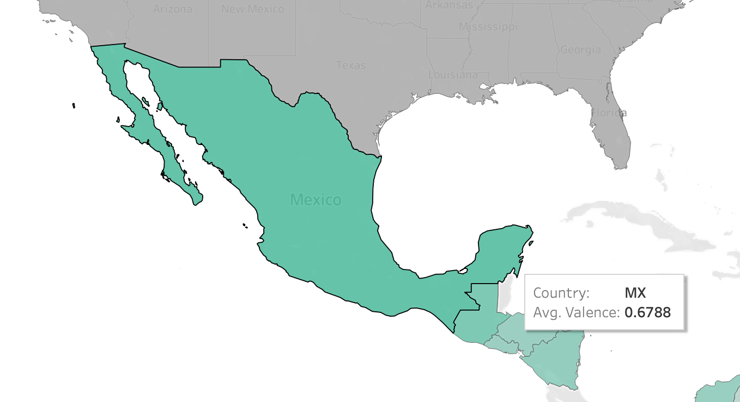
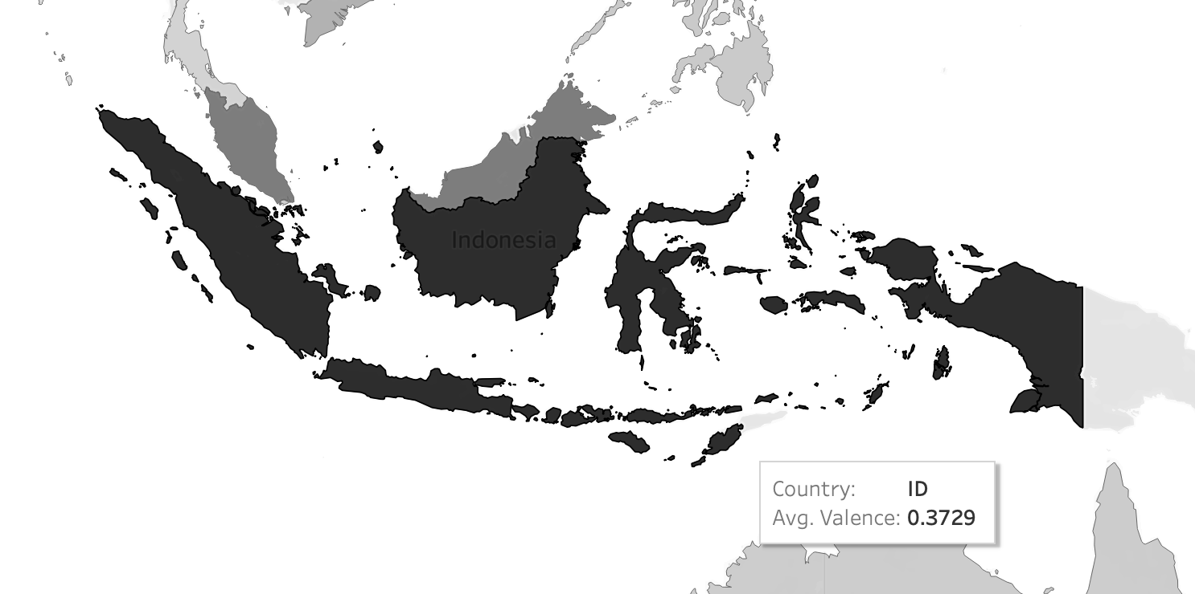
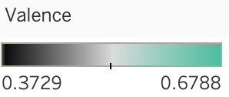
Preference Maps
Valence Preference Map
MAX
Mexico
MIN
Indonesia

Slide 20
Key Takeaways
Music popularity has been on a steady rise since the 1950s, and a boost after the 2010s shows how accessibility and digital platforms (Spotify, 2008) have transformed listening habits.
Hit songs typically fall within 210 seconds, 120 BPM, and mid-to-high energy (0.66), striking the perfect balance between engagement, danceability, and emotional impact.
Louder (dB) songs tend to have higher Energy, which often leads to higher Valence and lower Acousticness, and there are clear impacts of Tempo (BPM) on Danceability and Valence. A well-balanced mix of these music properties helps shape the perfect hit!
Music tastes vary across cultures, with different regions favoring unique blends of music’s Loudness, Energy, Danceability, and Valence, shaping distinct listening preferences worldwide.

Slide 21
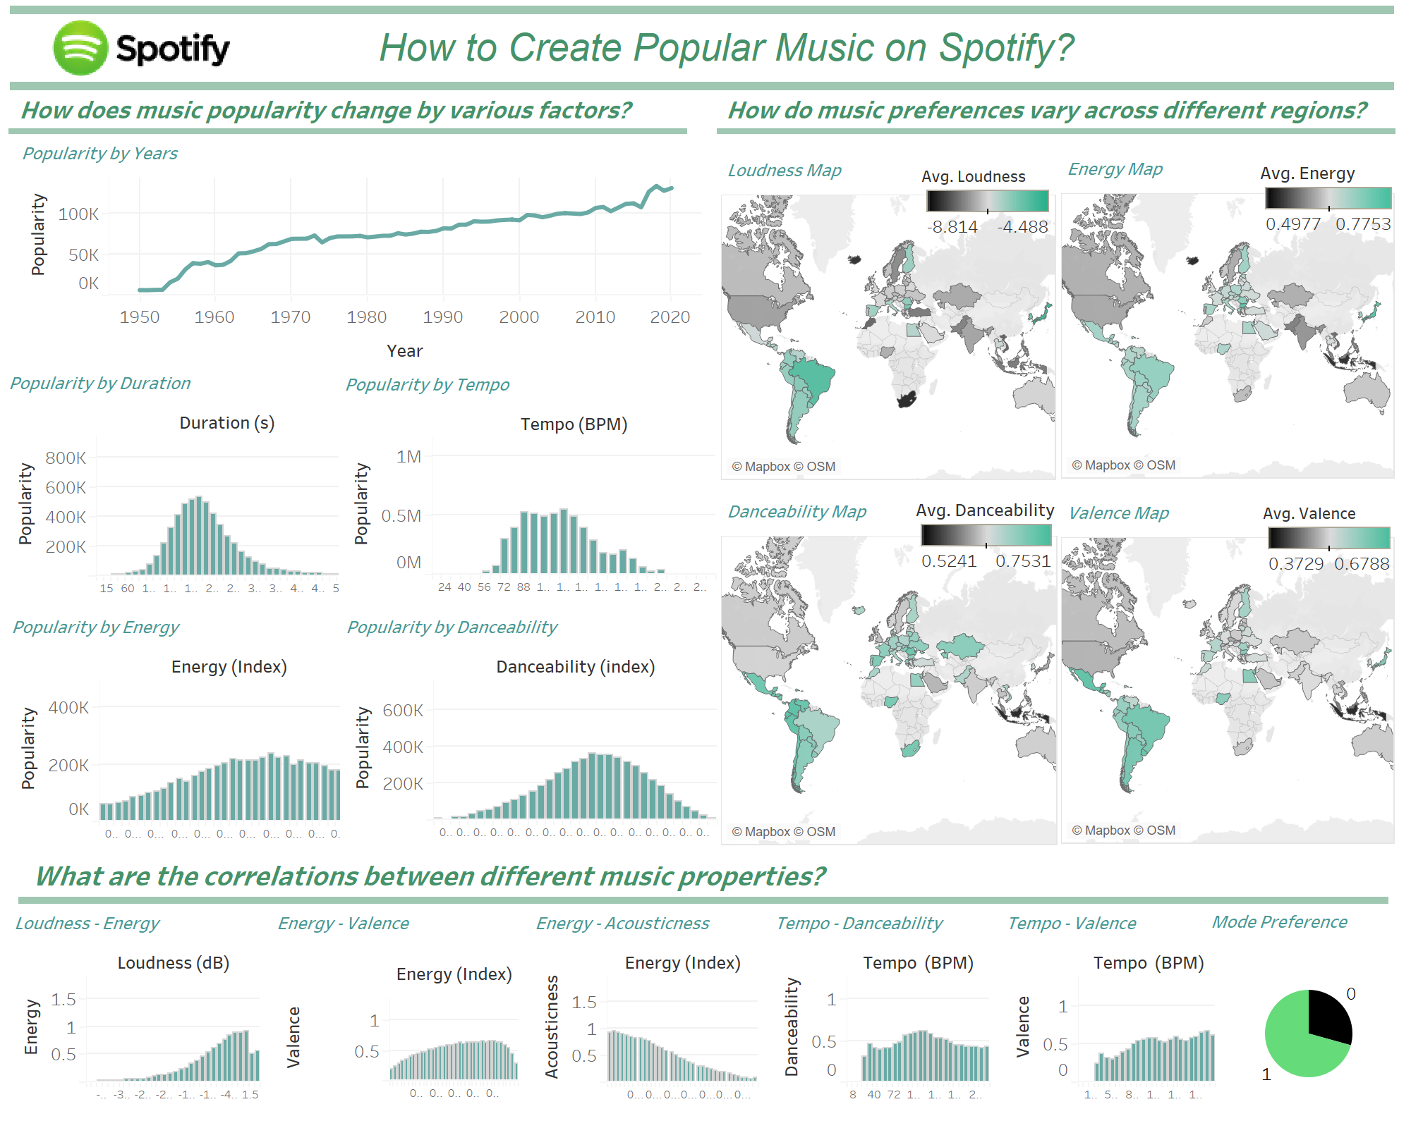
Dashboard

Slide 22
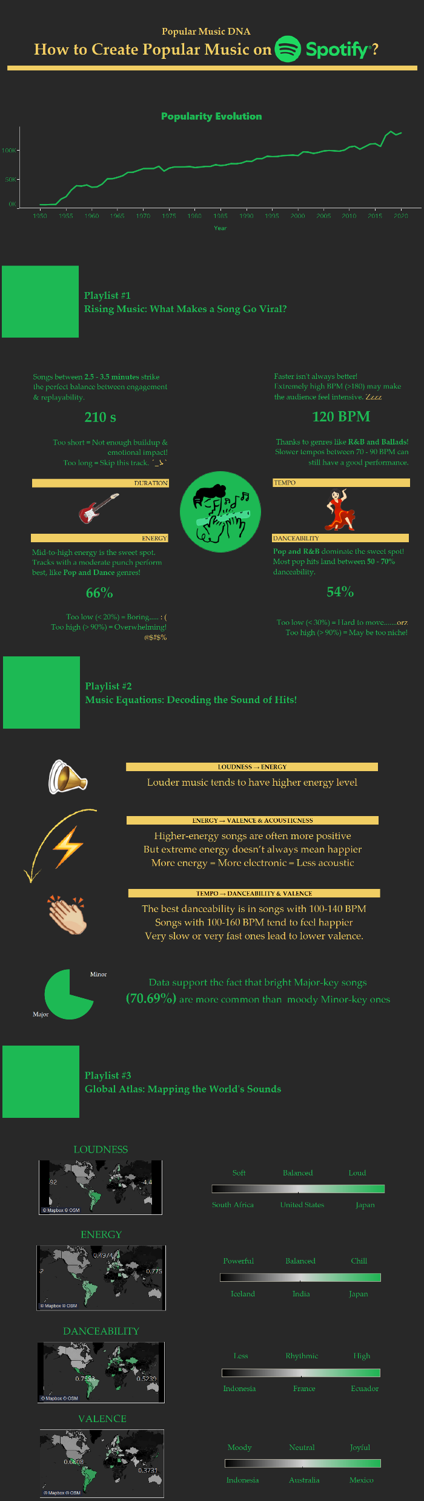
Infographic

Slide 23
THANKS!

